Slide 1
Kaggle Bike Sharing Demand Challenge
Merry Mekonnen & Rediet Negash -----> CSE-351(Intro to data science)

Slide 2
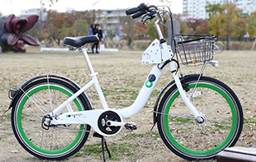
Inspiration for analysing this data
Bike sharing system is a bike rental system by which people are able to rent a bike from one location and return it to a different place as needed. It is automated via network through a city and is used to record a data that has the duration of travel, departure location, arrival location, and time elapsed which are generated by these systems. Hence, this functions as a sensor network that can be used for study in a mobility of a city.

Slide 3
Description of problem
The problem is to combine historical usage patterns with weather data in order to forecast bike rental demand in the capital bikeshare program.

Slide 4
Brief description of dataset
The dataset shows the:
DateTime, Season,
Holyday, WorkingDay,
Weather, Temperature,
Humidity, WindSpeed,
Casual, Registered, Count.
The dataset is used to forecast the bike rental demand based on the weather data provided in the above parameters.

Slide 5
Approaches : Data analysis tool and Steps Applied
1, Open the dataset:
We went to kagle website for bike demand and downloaded the train.csv data set..
https://www.kaggle.com/c/bike-sharing-demand
We then used our favorite data analysing tool weka to start our analysis.

Slide 6
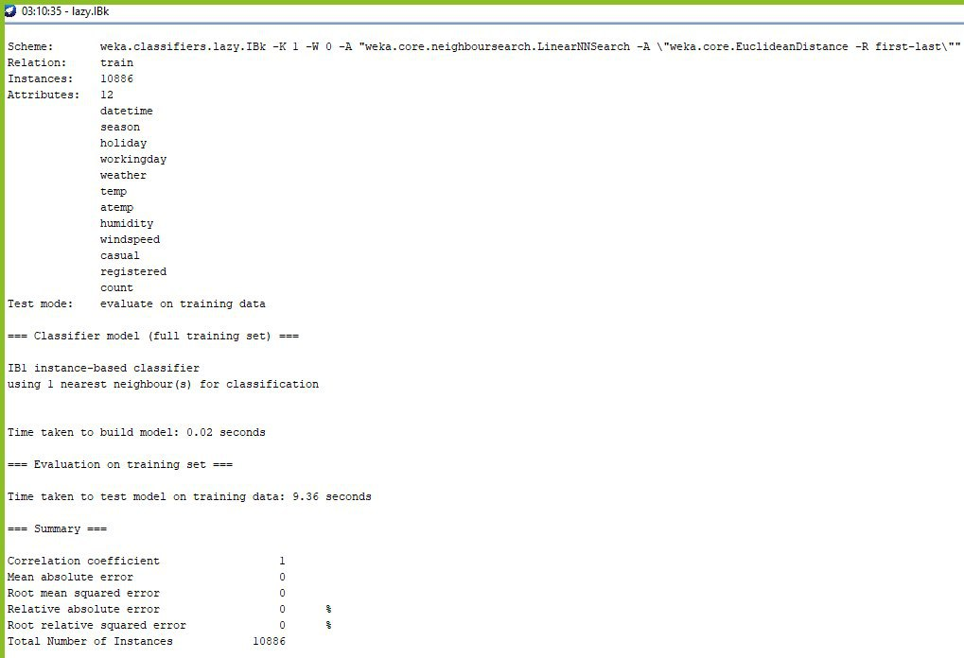
Approaches
2, Decide the best classification algorithm that predicts and classifies the data accurately:
We considered many different classification algorithms like naive bayes, j48 and other algorithms. However, they were all inefficient. Finally, we figured out IBK (K Nearest Neighbour) algorithm classifies the data with 100% accuracy with no errors recorded as shown in the picture on the left side.

Slide 7
Approaches
3, Find interesting relationships between the attributes and the classes.
The following are some of the analysis made and the relationships found.
Holiday Vs registered users
Temperature Vs Casual users
Wind speed Vs Casual Users
Wind speed Vs Registered Users
Working day Vs Registered Users

Slide 8
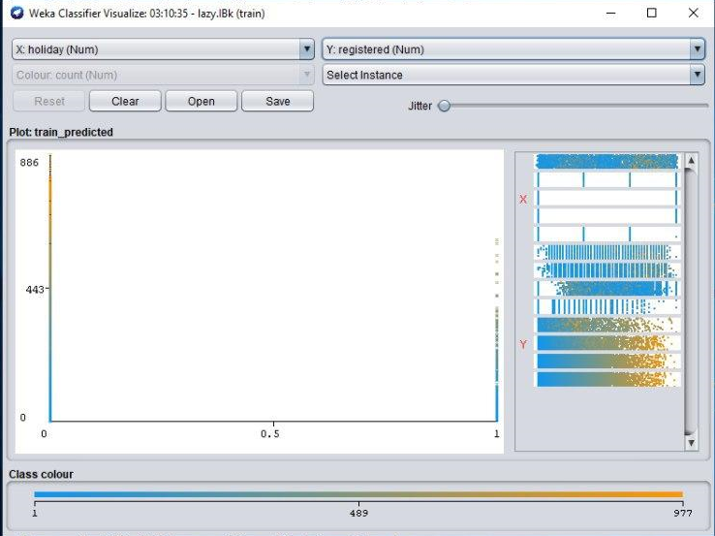
Relationship Analysis
Holiday Vs registered users
As on the Weka classifier Visualize shown, Holiday and registered users have a strong correlation. On holidays, most registered users do not bike. This implies that on holidays regular members do not have a preference to use bikes as a means of transportation.

Slide 9
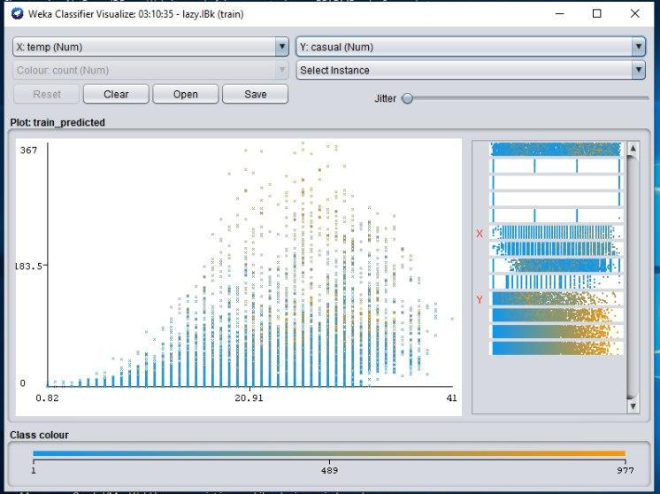
Relationship Analysis
Temperature Vs Casual users
On this visualizer, temperature and causal users have a positive correlation as shown. As temperature rises,many casual users tend to bike. We initially thought this relationship would be affected by humidity variable. However as our result shows, humidity does not affect the relationship between these two.

Slide 10
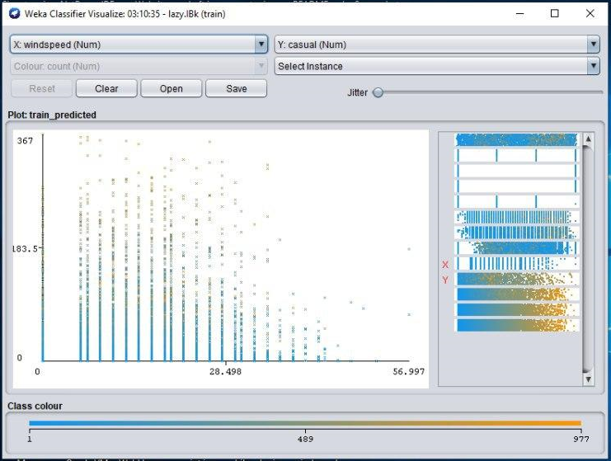
Relationship Analysis
Wind speed Vs Casual Users
As wind speed increase, fewer casual users tend to bike. This shows that when wind-speed increases people lose their interest to go out and bike.

Slide 11
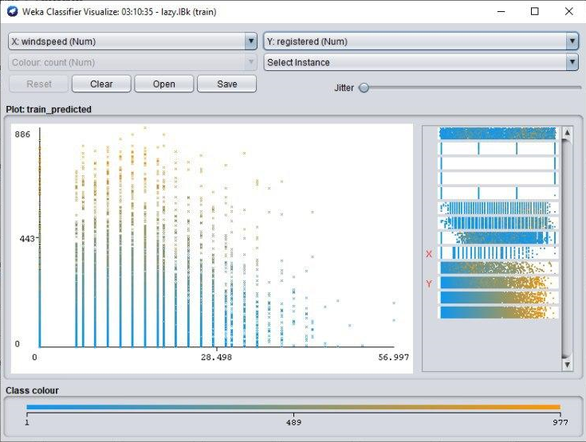
Relationship Analysis
Wind speed Vs Registered Users
Even though most registered users tend to bike on lots of days except for holidays and weekends, when the wind-speed increases, most of registered users do not bike. This implies that both casual and registered users tend to bike less on windy days.

Slide 12
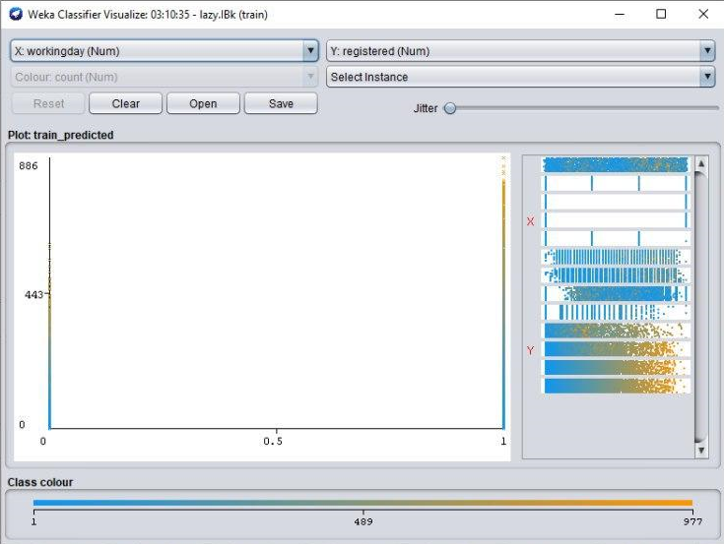
Relationship Analysis
Working day Vs Registered Users
On working days, many registered users bike. This implies that most of the registered users use their bike to go work.

Slide 13
Data preprocessing
--> We visualized how each attribute takes distinct values.
--> We observed the overall pattern of the dataset
--> We counted the number of distinct values each attribute takes.

Slide 14
Results
Our initial goal was to find relationships between the dataset attributes and forecast the bike rental demand. The results we found:
=> On windy days, there is a lower bike rental demand. Neither regular user nor casual user shows interest in biking on windy days.
=> On days where temperature is high, casual users tend to bike more. However, registered users when the temperature goes high, unless on weekends, don't bike.This implies that most of the registered users are busy on weekdays probably working or learning. The bike rental demand would be high if temperature goes high on weekends so that both casual users and regular users come looking for bike.
=> On holidays, there is almost no bike rental demand. This is presumably due to the fact that most people stay somewhere and don't have the interest to roam around.

Slide 15
Thank you!

